Slide 1
HOSA Area 2: The Opioid Crisis
October 22, 2022
Westside High School
HOSA Area 2 Conference
Presented by Anna H. Haro, Pharm.D.

Slide 2
LEARNING Objectives TEKS: §130.223.(c)(1)(A and B) and (c)(2)(A,B,C, and F)
The students will develop new knowledge and skills related to the opioid crisis in America.
The students will recognize patient behaviors and patterns leading to opioid addiction: Rx – misuse – abuse - addiction
The students will apply medical terminology related to addiction disorders (tolerance, dependence and withdrawal).
The students will evaluate the likely causes and the problems of the opioid crisis in America.

Slide 3
Objetivos de aprendizaje TEKS: §130.223.(c)(1)(A and B) and (c)(2)(A,B,C, and F)
Los estudiantes desarrollarán nuevos conocimientos y habilidades relacionados con la crisis de opioides en Estados Unidos.
Los estudiantes reconocerán los comportamientos y patrones de los pacientes que conducen a la adicción a los opioides: Rx - mal uso - abuso - adicción
Los estudiantes aplicarán terminología médica relacionada con los trastornos de adicción.
Los estudiantes evaluarán las causas probables y los problemas de la crisis de opioides en Estados Unidos.

Slide 4
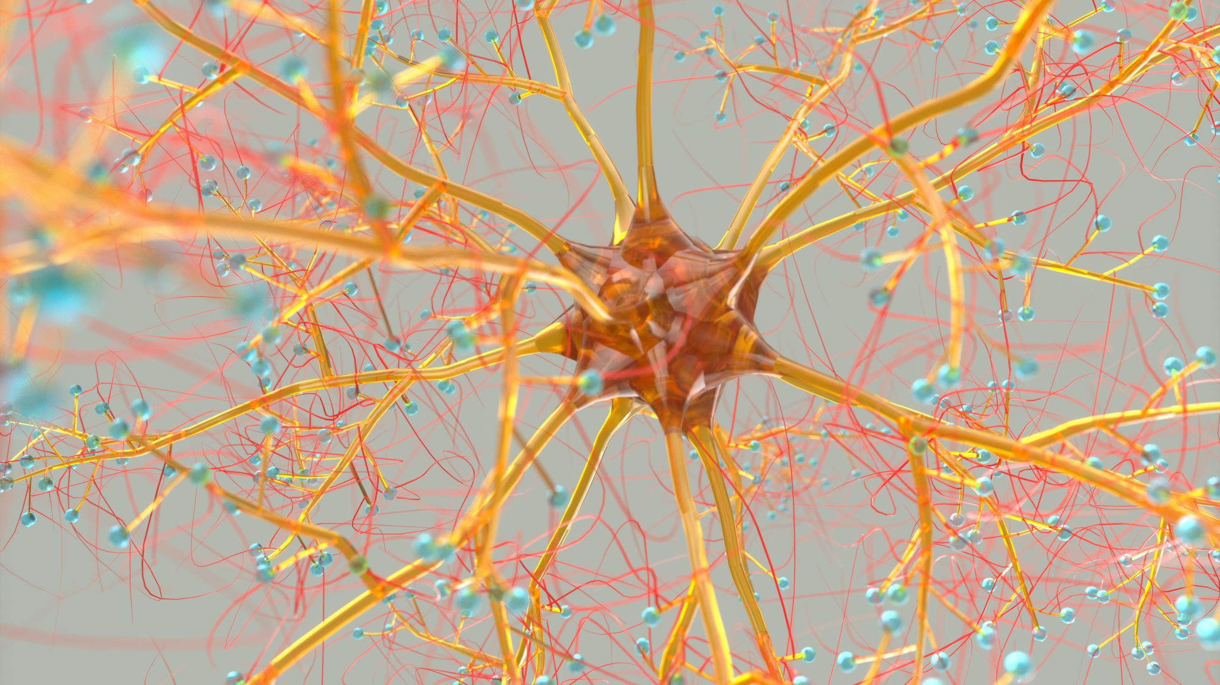
Disclaimer
Disclaimer: The information discussed during the HOSA Presentation is intended to inform and educate high school students. The presentation does not replace the advice and individualized care from a qualified mental health care provider. However, please know that I am available to listen should you or a friend need help. I will guide you to the counselors and social worker if needed, and I can provide fact-based answers and resources about your medications and treatment. Text @DrHaroM to 81010

Slide 5
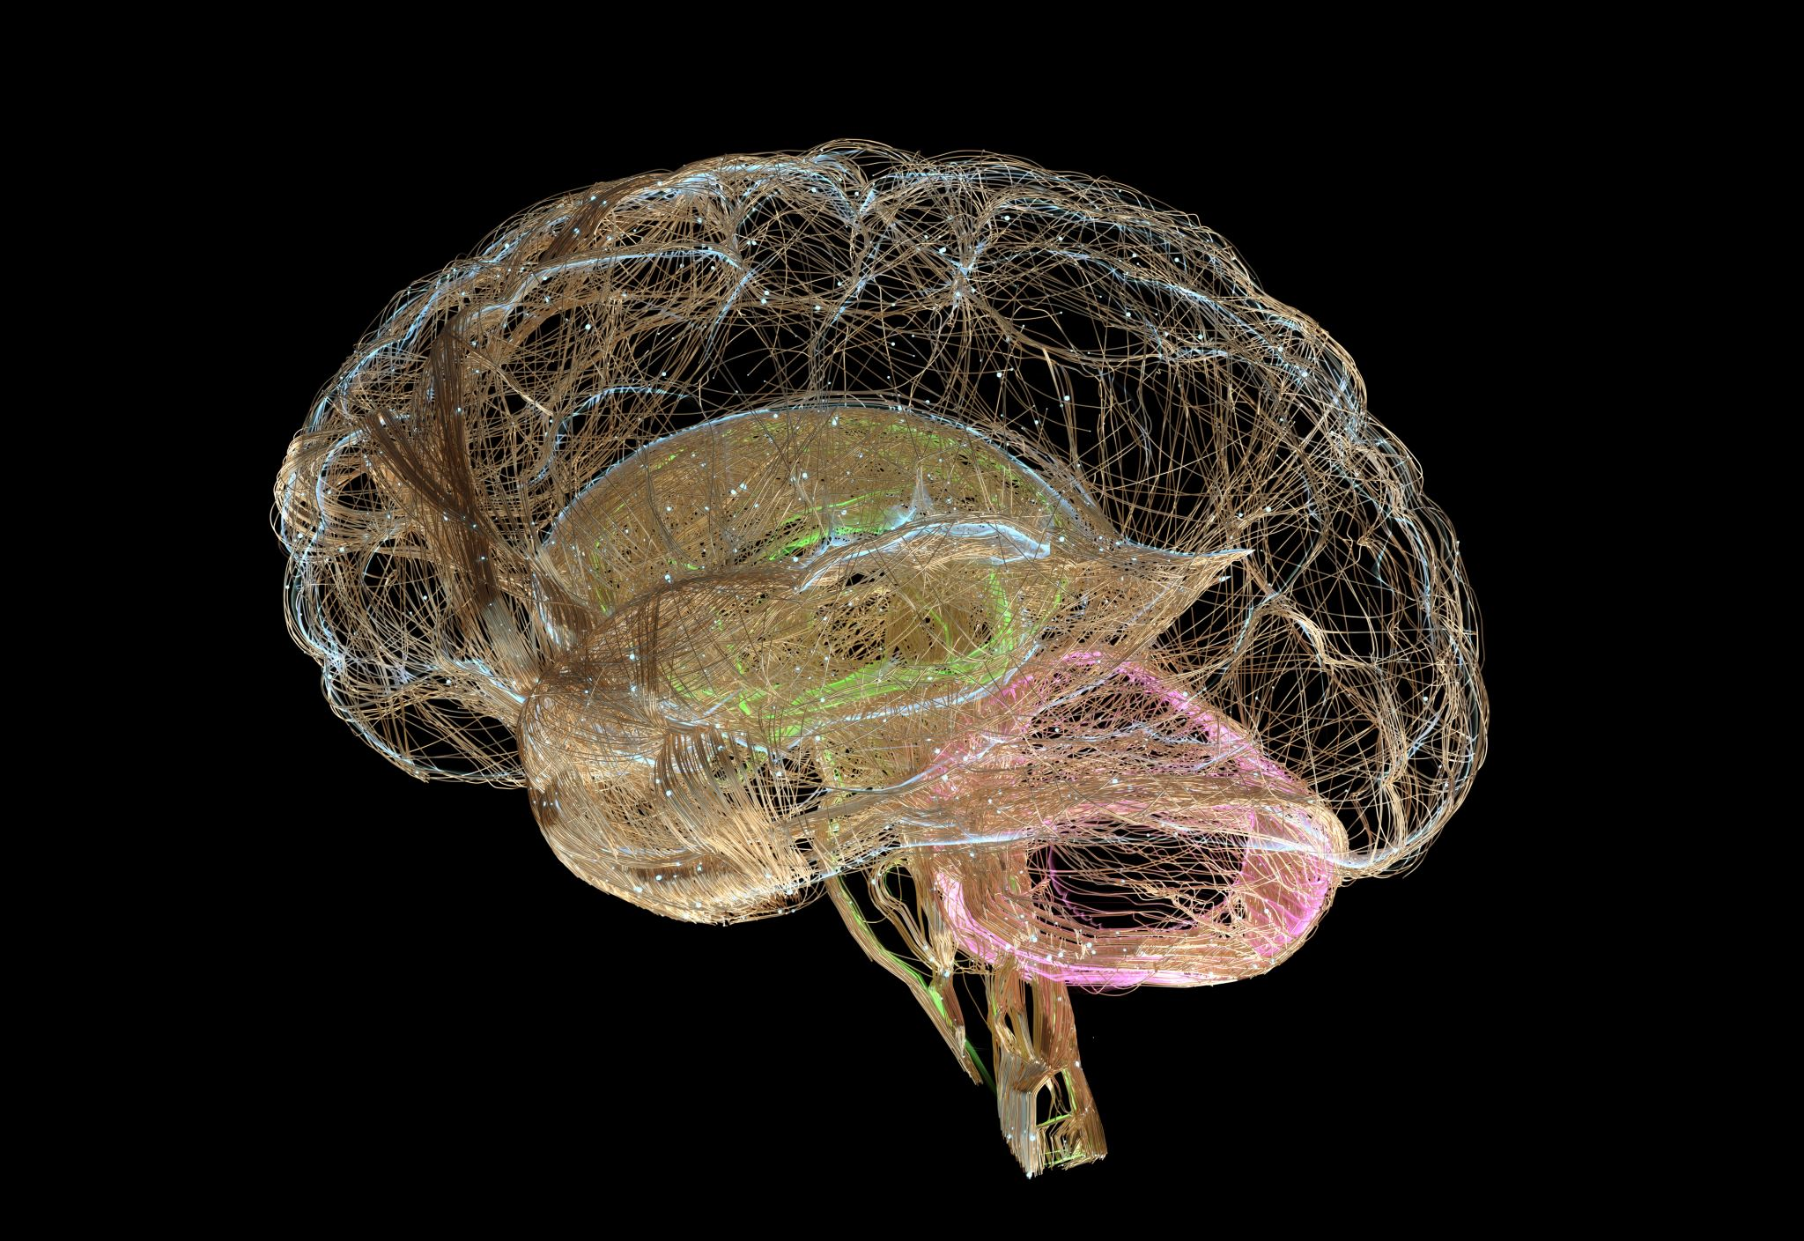
What is an opioid?
An opioid is a substance, usually a drug or prescription medication, that is chemically related to the natural substance, opium, from the poppy flower.
Opioids or opiates (drugs chemically related to opium) are used medically to treat pain.
Located within the central nervous system, humans have opiate receptors, specifically Mu-opiate receptors, that when stimulated, create a strong analgesic effect and block pain signals in the brain. At the therapeutic dose, patients do not feel pain.

Slide 6
Opioids
Ex. include hydrocodone, oxycodone, codeine, morphine, hydromorphone, fentanyl (Norco®, Vicodin®, Dilaudid® and OxyContin®)
Mechanism of action (MOA): Opioids block pain through ”inhibition of neurotransmitter release from the primary afferent terminals in the spinal cord and activation of descending inhibitory controls in the midbrain.”
Opioids activate or stimulate the mu-opioid receptors within the cell membranes of ____________ to block the pain signals.
Natural and synthetic opioids block pain, ranging from mild to severe.

Slide 7
Opioids
Opioid prescription drugs are classified as Schedule II Controlled substances.
Schedule II drugs are the most strictly regulated and controlled of all RX drugs. Writing, filling, ordering, and dispensing these drugs have lengthy legal protocols. Failure to comply results in loss of employment and loss of professional licenses, along with federal crime prosecution and penalties. (fines and prison). Discussion Reflection Question : is it worth it???
Schedule II drugs, including opioids have the highest potential for physiological and psychological abuse and addiction.
In comparison, Schedule I drugs (heroin, PCP, LSD, Ecstasy, some forms of marijuana, etc.) have NO medical use are illegal in all settings in the US.

Slide 8
Opioid Side Effects -why are they so addictive?
Constipation
Nausea
Confusion
Somnolence – meaning sleepiness/drowsiness
Euphoria – discussion question: what does this mean?
Decreased respiration (respiratory depression – usual cause of OD deaths, especially with fentanyl)
Decreased HR and BP (opioids are not stimulants, but rather “depressants” since they block or inhibit signals) - what other common substances of abuse are considered depressants?

Slide 9
Substance Abuse Definitions
“Addiction is defined as a chronic, relapsing disorder characterized by compulsive drug seeking, continued use despite harmful consequences, and long-lasting changes in the brain. It is considered both a complex brain disorder and a mental health illness. Addiction is the most severe form of a full spectrum of substance use disorders, and is a medical illness caused by repeated misuse of a substance or substances.” from https://www.drugabuse.gov/publications/media-guide/science-drug-use-addiction-basics
A person becomes _________ to a substance when the psychological and physiological changes prevent the patient from stopping use of the substance even though the person may or may not be aware of the dangerous consequences of use of the substance or drug.

Slide 10
Symptoms and cravings
Physiological symptoms are related to the body’s physical functioning:
Heart rate, blood pressure, temperature, digestion, metabolism, sleep
_________ symptoms are related to the mental and emotional state of the patient:
Mood, anxiety, calm, sleep, problem solving, decision- making, critical thinking, and others
A craving is an intense urge to use or consume a substance. Discuss: are cravings physiological or psychological?

Slide 11
More medical terms of addiction
Tolerance occurs when the body needs more of a substance to induce an intended or desired effect. Tolerance is caused by chemical and physical changes in the brain. NT levels are depleted and NT receptor sites on the cell membranes of neurons become desensitized. The “connections” between neurons do not work as efficiently.
Dependence occurs when the patient needs the substance or drug to continue functioning at their “normal” levels. Dependence can include both physiological and psychological symptoms. If the patient stops the dependent substance, then they WILL experience withdrawal symptoms.
Withdrawal is the response to dependence when the patient stops using the substance or drug. Typically, the symptoms of withdrawal create the opposite physiological and psychological symptoms compared to the desired effects of the drug.

Slide 12
How does opioid addiction occur?
Opioid addiction, like other substance use disorders, develops through a similar pattern:
May or may not start as a legal RX.
Misuse of opioid or RX drug (share a pill with family member or friend in pain, take an extra dose to help sleep, double up on pills by mistake, forgetting when they took the last dose). What is misuse?
Misuse evolves to abuse: initially, it was just a few times, but now, patient is intentionally misusing to experience desired effects (pain relief and euphoria)
Abuse leads to _________: due to chemical and physical changes in the brain, pt can no longer stop use of the drug. (tolerance, dependence, and withdrawal)

Slide 13
The Opioid Crisis
The opioid crisis is a national pandemic leading to overdose and death caused by addiction to opioid substances.
In 2018, approximately 128 deaths per day were caused by overdose from opioids.
Just this past week, 30,000 boxes of candy were confiscated at LAX (LA International Airport) containing about 12,000 fentanyl tablets.
“The Centers for Disease Control and Prevention (CDC) estimates that the total "economic burden" of prescription opioid misuse alone in the United States is $78.5 billion a year, including the costs of healthcare, lost productivity, addiction treatment, and criminal justice involvement.” The cost to society, to families, and to communities is even greater.

Slide 14
The Opioid Crisis – the beginning
In the late 1990’s pharmaceutical companies began to create, market, and sell prescription pain medications, claiming they cured pain but had low risk for addiction.
In the early 2000’s, addiction and overdose were occurring. The pharmaceutical response was to develop addiction proof or abuse-deterrent medication formulations. (ex. OxyContin® by Purdue Pharma)
Over two decades, patients found methods to bypass the deterrents and the illegal use of RX opioid drugs surpassed the use of other illicit and illegal drugs of abuse.
FYI: in the meanwhile, tobacco companies were also developing, marketing, and selling alternative forms of tobacco/nicotine products with similar “safety” claims (ex. Vaping)

Slide 15
The Opioid Crisis – Patients
By 2017, an estimated 98,000 patients died in the US from opioid drug-related causes.
In 2018, the death rate doubled to nearly 200,000 patient deaths due to opioid-related causes of death.
New data from the CDC show opioids as the “actual” cause of death to be much lower than the initial data. However, opioid OD was not included in the list of causes of death on death certificate statistics. Additionally, CDC data clearly indicates opioid-OD deaths have more than quadrupled over the past 2 decades.
During the COVID pandemic, death rates continued to skyrocket due to opioid OD.
In 2019-2020, Purdue Pharmaceutical was sued more than $20 billion by state and federal governments. In late 2020, the company filed for bankruptcy. The moneys are intended to fund drug addiction programs.

Slide 16
The Opioid Crisis – Now what???
What do you think caused the opioid crisis?
What can be done now to prevent future drug ODs and to help patients who are currently addicted?
Narcan® or naloxone nasal spray – antidote to opioid OD. This is available at all pharmacies without a RX. Narcan® should be administered immediately, even to an unconscious patient/person, then call 911. https://www.narcan.com/

Slide 17
Opioids
What questions do you have for me today?
Email: Anna.Haro@houstonisd.org
Use Remind for additional Q/A. Text @DrHaroM to 81010

Slide 18
References
https://www.drugabuse.gov/drug-topics/opioids/opioid-overdose-crisis#:~:text=2018%20data%20shows%20that%20every,die%20after%20overdosing%20on%20opioids.&text=The%20misuse%20of%20and%20addiction,as%20social%20and%20economic%20welfare.
https://www.ncbi.nlm.nih.gov/books/NBK28234/#:~:text=5%2Dht1F%20receptor%20mRNA,of%20adenylyl%20cyclase%20%5B16%5D.
https://www.ncbi.nlm.nih.gov/pmc/articles/PMC3131098/#:~:text=Several%20lines%20of%20evidence%20suggest,and%20treatment%20of%20depressive%20disorders.&text=NE%20projections%20from%20the%20locus,in%20the%20regulation%20of%20emotions.
https://en.wikipedia.org/wiki/Norepinephrine#:~:text=In%20the%20rest%20of%20the,the%20bladder%20and%20gastrointestinal%20motility.
https://www.drugabuse.gov/publications/research-reports/cocaine/how-does-cocaine-produce-its-effects
https://www.ncbi.nlm.nih.gov/pmc/articles/PMC2851032/

Slide 19
Additional References
https://www.mayoclinic.org/diseases-conditions/mental-illness/symptoms-causes/syc-20374968
https://www.ncbi.nlm.nih.gov/books/NBK28234/#:~:text=5%2Dht1F%20receptor%20mRNA,of%20adenylyl%20cyclase%20%5B16%5D.
https://www.ncbi.nlm.nih.gov/pmc/articles/PMC3131098/#:~:text=Several%20lines%20of%20evidence%20suggest,and%20treatment%20of%20depressive%20disorders.&text=NE%20projections%20from%20the%20locus,in%20the%20regulation%20of%20emotions.
https://en.wikipedia.org/wiki/Norepinephrine#:~:text=In%20the%20rest%20of%20the,the%20bladder%20and%20gastrointestinal%20motility.
https://www.drugabuse.gov/publications/research-reports/cocaine/how-does-cocaine-produce-its-effects
https://www.ncbi.nlm.nih.gov/pmc/articles/PMC2851032/

